Slide 1

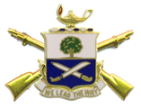
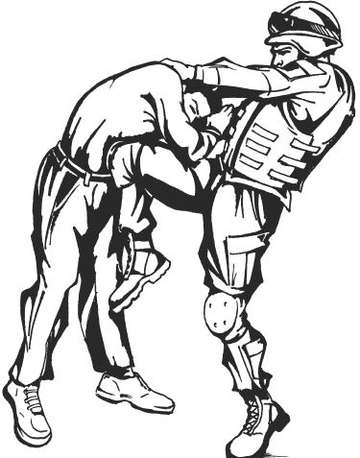
Combatives Instructor Book Example
UNITED STATES ARMY COMBATIVES COURSE
1/29 Infantry Regiment, Fort Moore GA
Notes:
This is an example of what an Instructor Book should contain. Instructor books will vary based on different needs of the POI. The examples in this presentation are available for download on the USACC website at http://www.Moore.army.mil/armor/316thCav/129/Combatives/

Slide 2
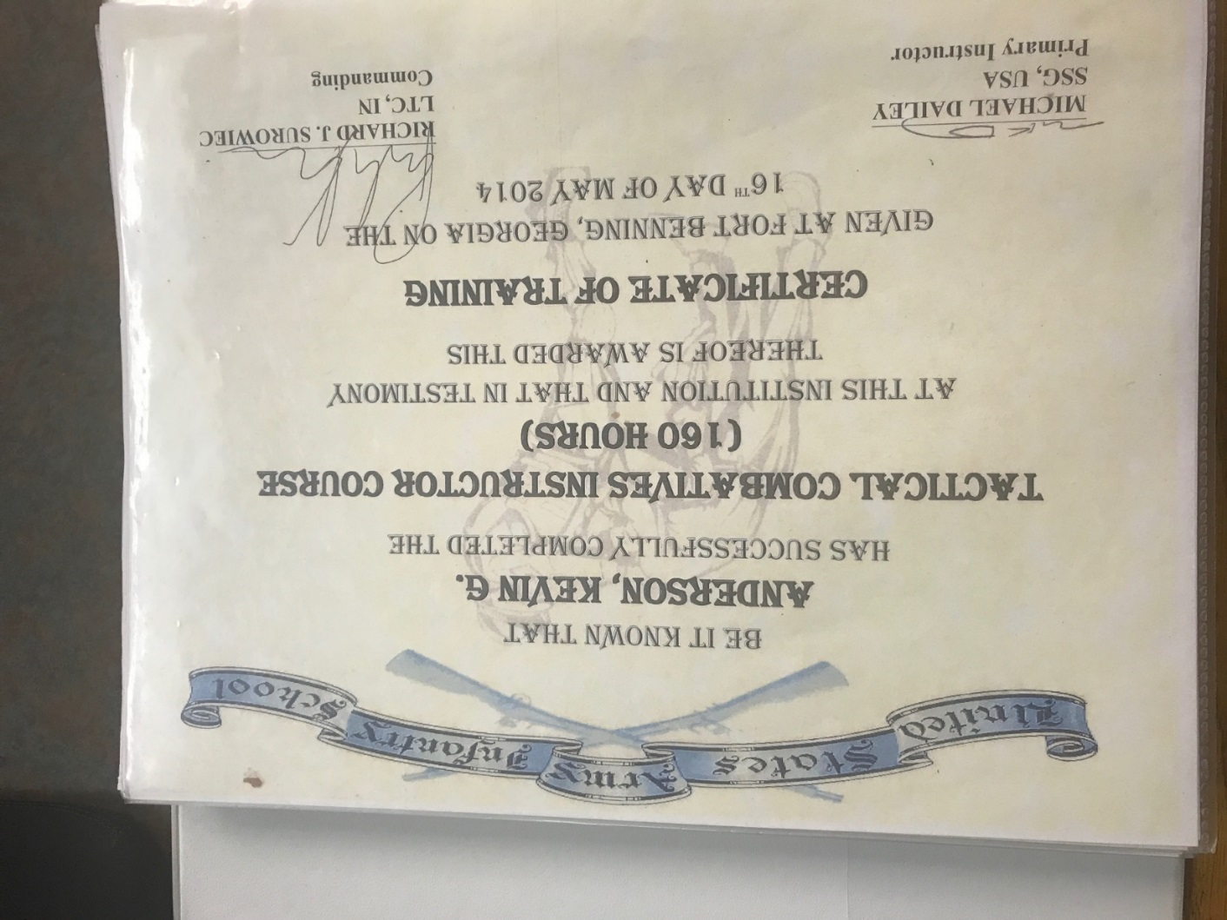
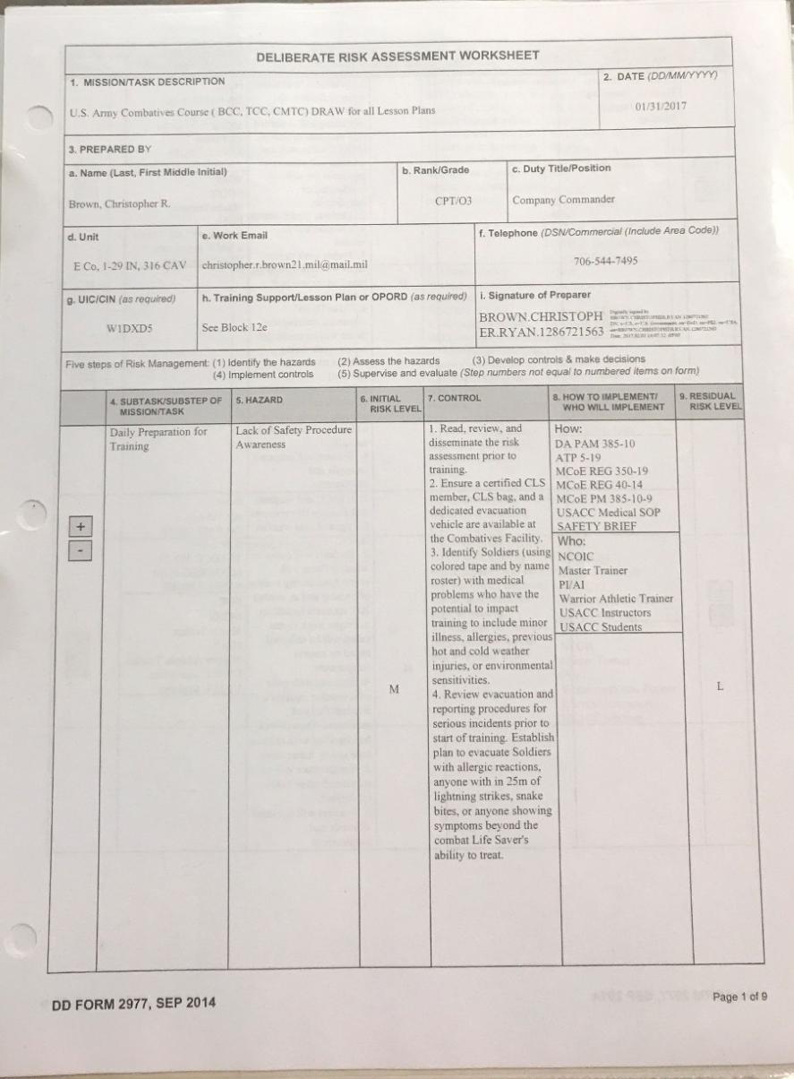
UNITED STATES ARMY COMBATIVES COURSE
1/29 Infantry Regiment, Fort Moore GA
Instructor Certificate
Deliberate Risk Assessment Worksheet
Notes:
Instructor Certificate: Should be the first thing in your Instructor Book. For responsibilities and authorizations of each certification, reference TC 3-25.150 or the handout on the USACC website.
Deliberate Risk Assessment Worksheet: Should be the second document in your instructor book. Outlines the risks and control measures for safe training. A blanket Combatives DRAW is available on the USACC website.

Slide 3
UNITED STATES ARMY COMBATIVES COURSE
1/29 Infantry Regiment, Fort Moore GA
Visitor Log
Hold Harmless Waiver
Notes:
Visitor Log: Should keep a blank copy in your instructor book. The working copy should function as a “Sign-In” sheet to keep a record of the numbers of Soldiers who train at your facility. Funding stops when numbers go down, so keep up with the record.
Hold Harmless Waiver: Should be with the Visitor Log. Anybody who is not ARNG, AR, or RA or the equivalent in other services is required to sign a hold-harmless waiver prior to participating in physical training of any kind at the facility. An example can be found on the USACC website and should be reviewed by legal at your post.

Slide 4
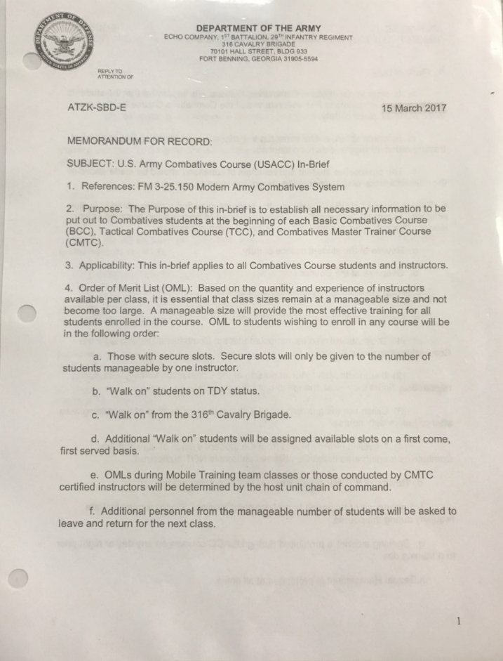
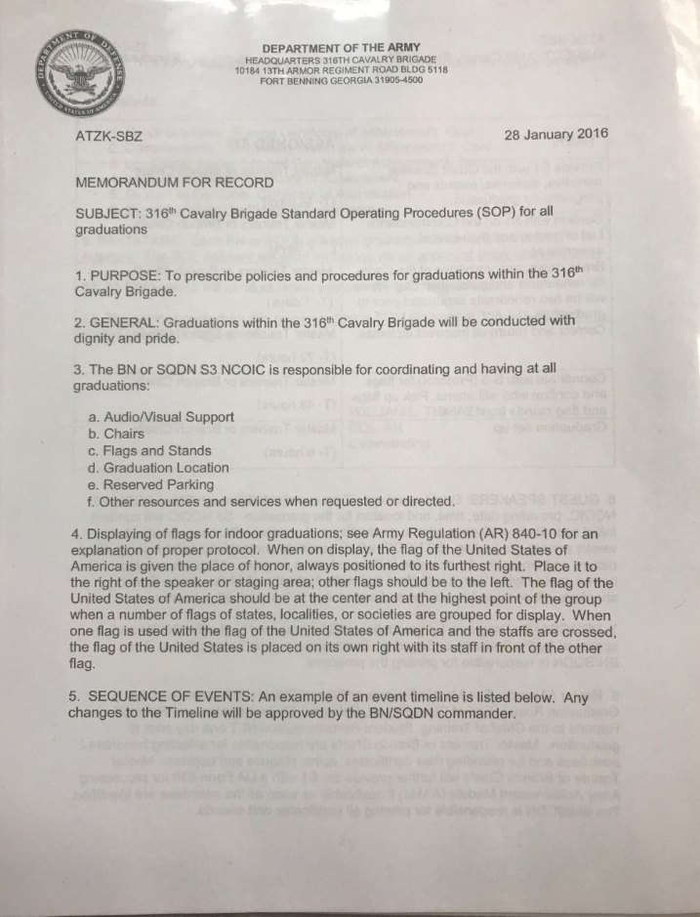
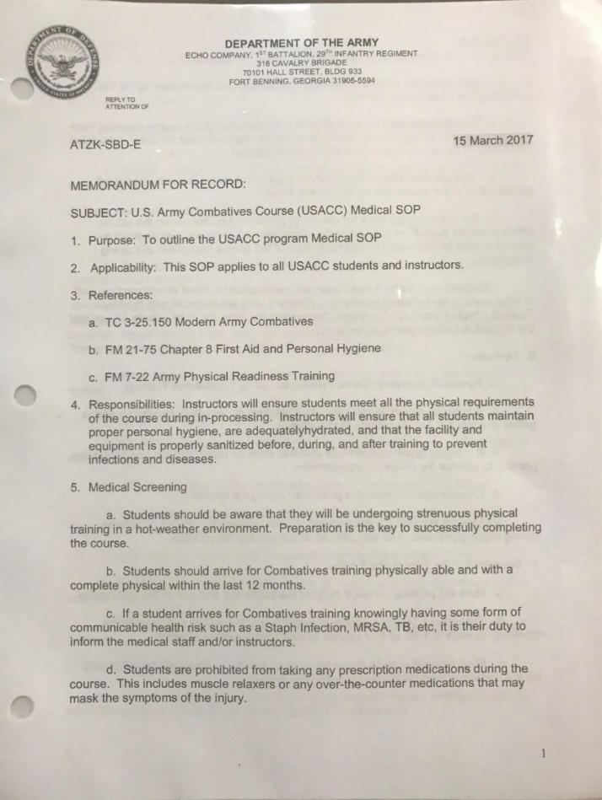
UNITED STATES ARMY COMBATIVES COURSE
1/29 Infantry Regiment, Fort Moore GA
Unit/Course In-Brief
Course SOP
Course Medical SOP
Notes:
Unit/Course SOP: Outlines all relevant administrative information for the course to include OML, Off-post sanctions, safety information, etc.
Course SOP: Prescribes guidelines and procedures for the daily operations of the course to include accountability, standards of conduct, testing procedures, disciplinary procedures, rebuttal procedures, etc.
Course Medical SOP: Prescribes medical guidelines and procedures to include student hygiene, medical screening, sick call procedure, etc.

Slide 5
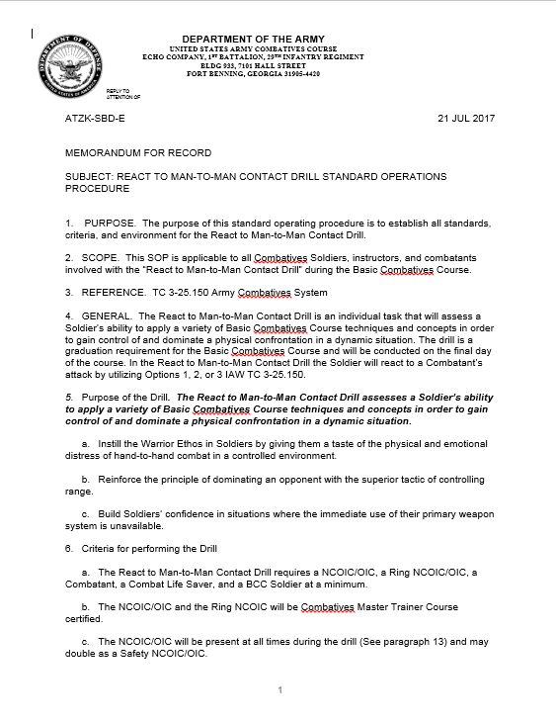
UNITED STATES ARMY COMBATIVES COURSE
1/29 Infantry Regiment, Fort Moore GA
Option 3 SOP
Option 3 Annex A
React to Man-to-Man Contact Drill SOP
Notes:
Option 3 SOP: Required for all instructors who teach the BCC. Can be found on the USACC website for download.
Option 3 Annex A: Outlines the required training for all Soldiers and Instructors before participating in the Option 3 Drill. Required for all BCC Instructors.
React to Man-to-Man Contact Drill SOP: Required for all BCC Instructors. Outlines the procedure for the “React to Man-to-Man Contact Drill as a BCC requirement.

Slide 6
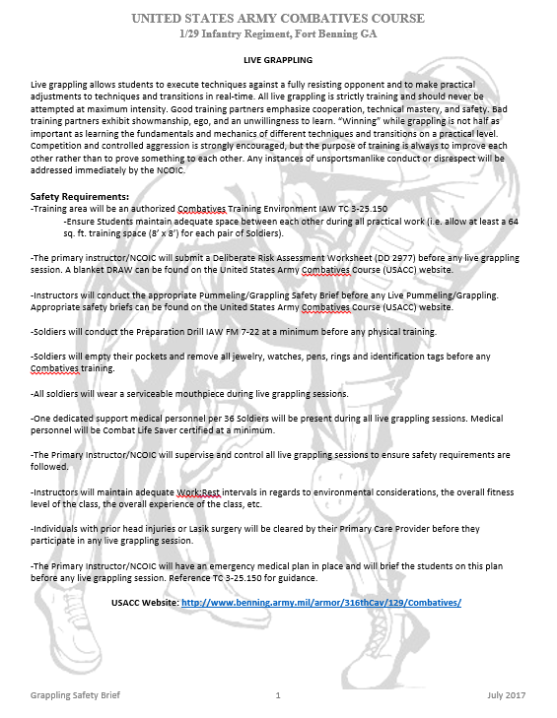
UNITED STATES ARMY COMBATIVES COURSE
1/29 Infantry Regiment, Fort Moore GA
Option 3 Oral Brief: Students
Option 3 Oral Brief: Punchers
Grappling Safety Brief
Notes:
Option 3 Oral Brief (Students): Required for all BCC Instructors. Instructors will use this to brief students before every Option 3 Drill.
Option 3 Oral Brief (Punchers) Required for all BCC Instructors. Instructors will use this to brief Punchers separately from the Students before every Option 3 Drill.
Grappling Safety Brief: Required for all Combatives Instructors. A series of briefs that contain several grappling situations. Instructors will brief Soldiers with one of the following briefs at a minimum and are encouraged to add on to the brief as necessary but will never take away from it.

Slide 7
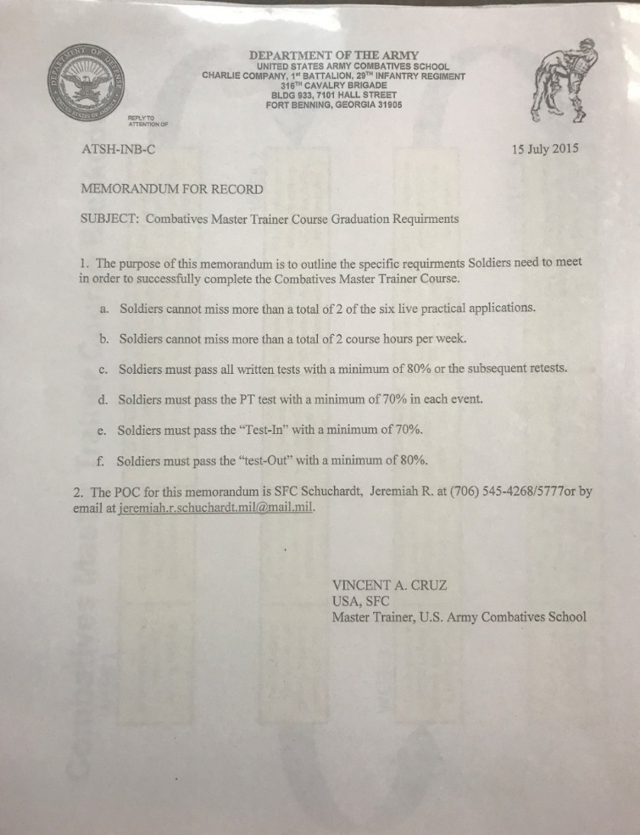
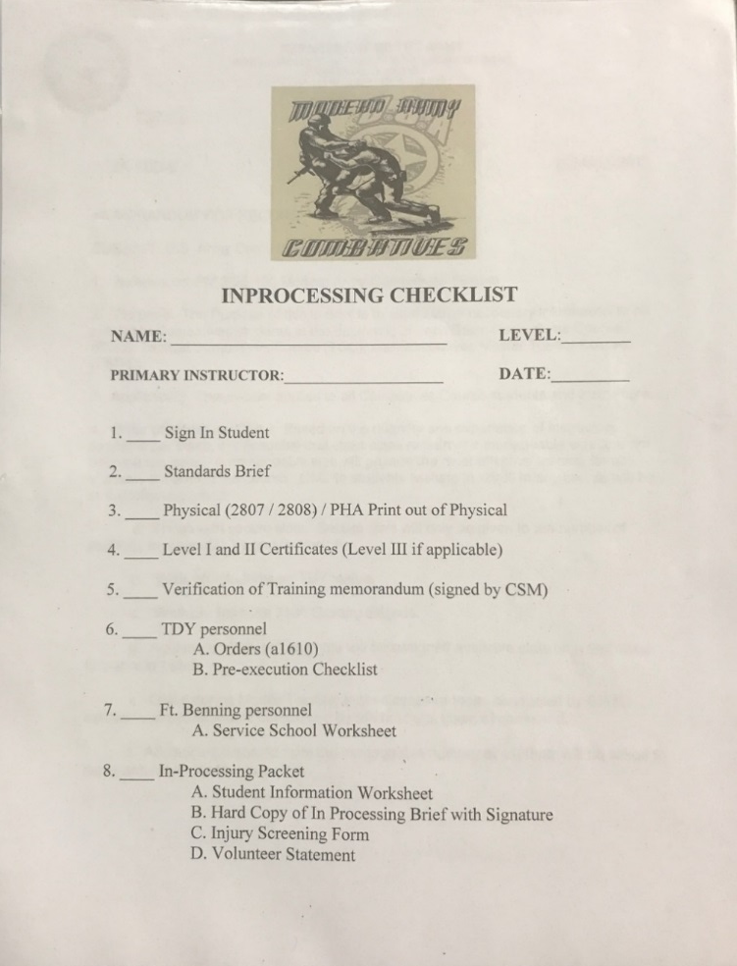
UNITED STATES ARMY COMBATIVES COURSE
1/29 Infantry Regiment, Fort Moore GA
Course Graduation Requirements
Student In-Processing Checklist
Notes:
Course Graduation Requirements: Outlines the specific Graduation Requirements for a given course. Instructors who teach several courses (BCC/TCC) should have the graduation requirements for each course. The BCC and TCC Graduation Requirements can be found on the USACC website.
Student In-Processing Checklist: Course/Unit specific. Outlines everything that students who attend the course must have in their individual packets.

Slide 8
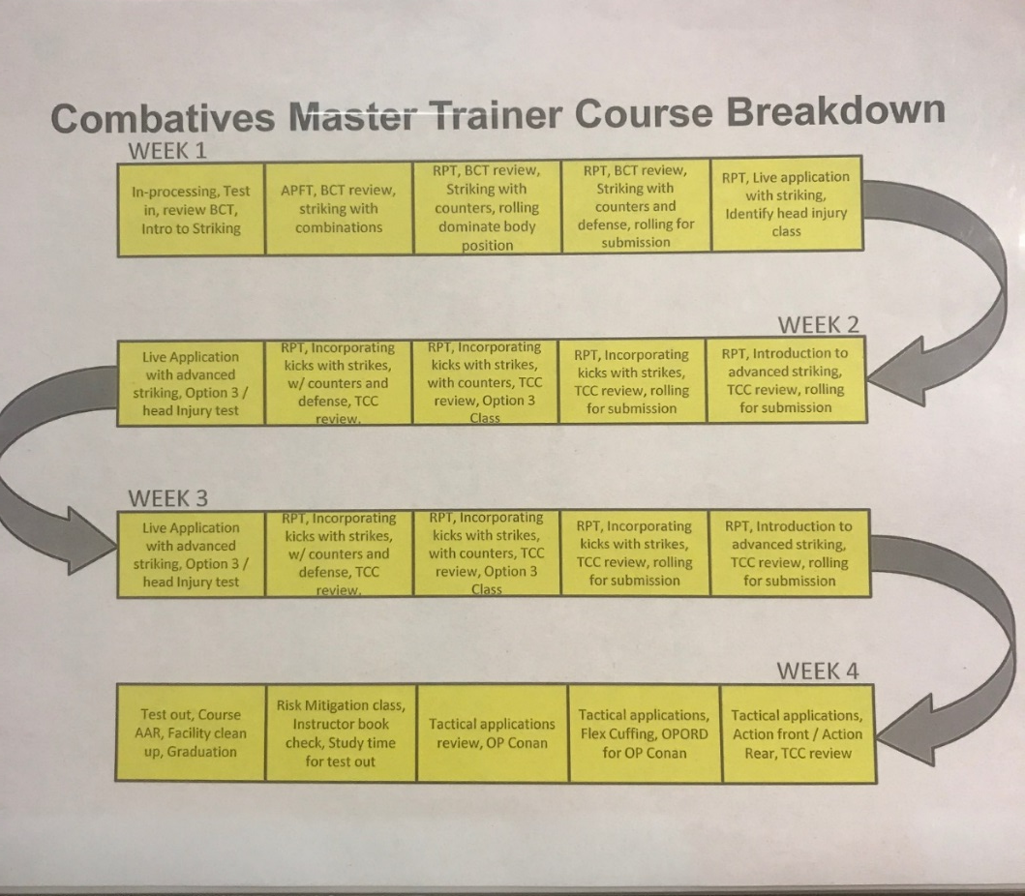
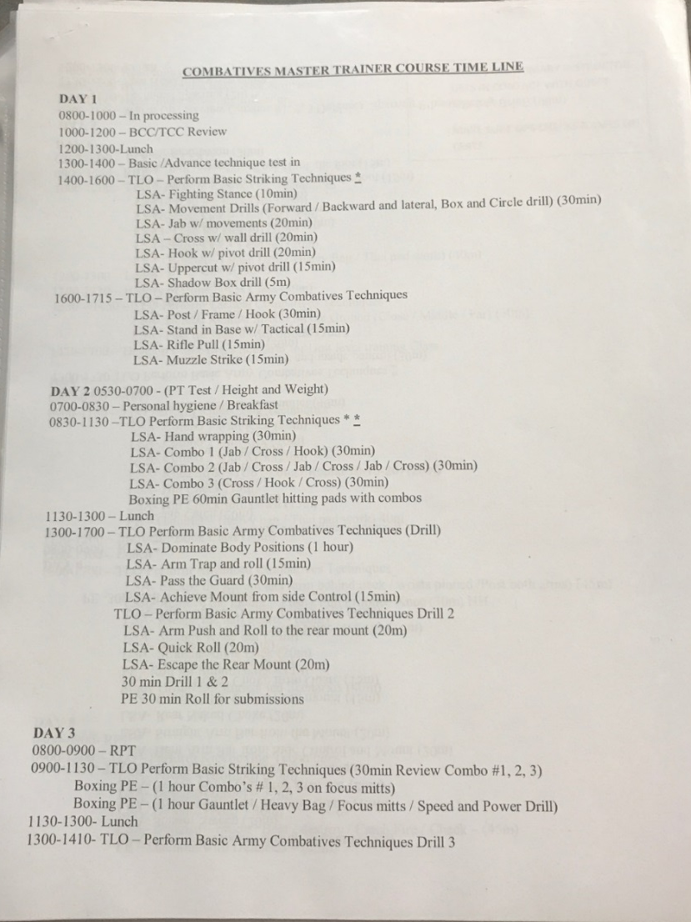
UNITED STATES ARMY COMBATIVES COURSE
1/29 Infantry Regiment, Fort Moore GA
Course Breakdown
Course Timeline
Notes:
Course Breakdown: An overview of the course material. CMTC Breakdown is shown in example. Instructors should have a course breakdown for every course that they instruct (BCC/TCC). Course maps can be found on the USACC website.
Course Timeline: The Course broken down by each day with the training broken down by hour. Instructors who teach multiple courses should have the timeline for each available. BCC and TCC timelines are available on the USACC Website.

Slide 9
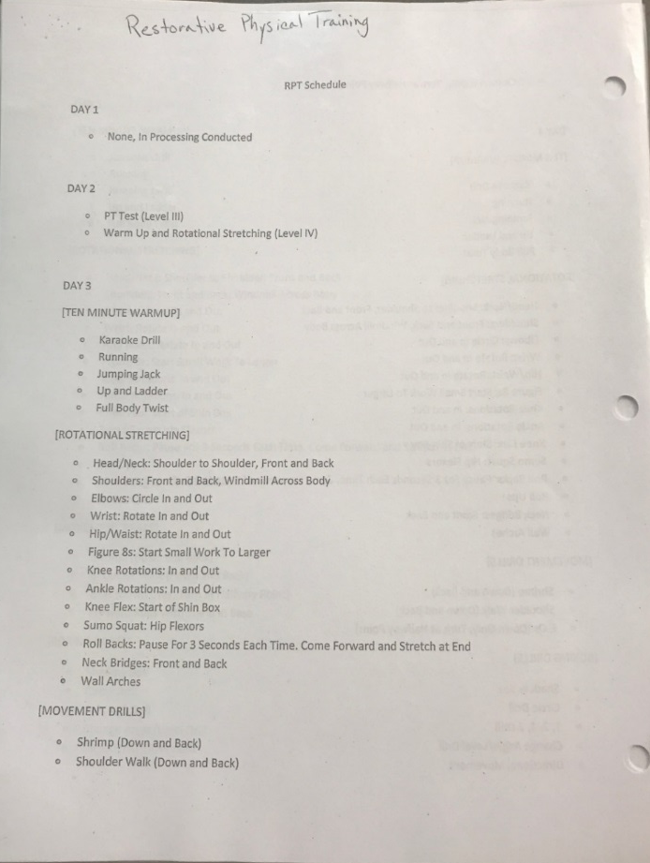
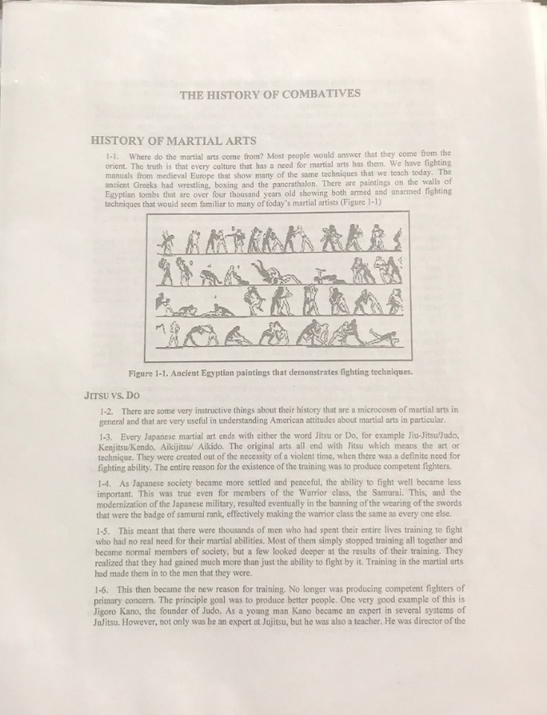
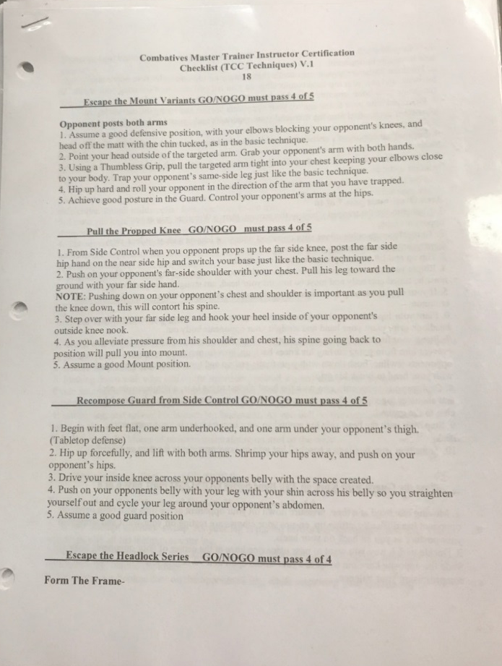
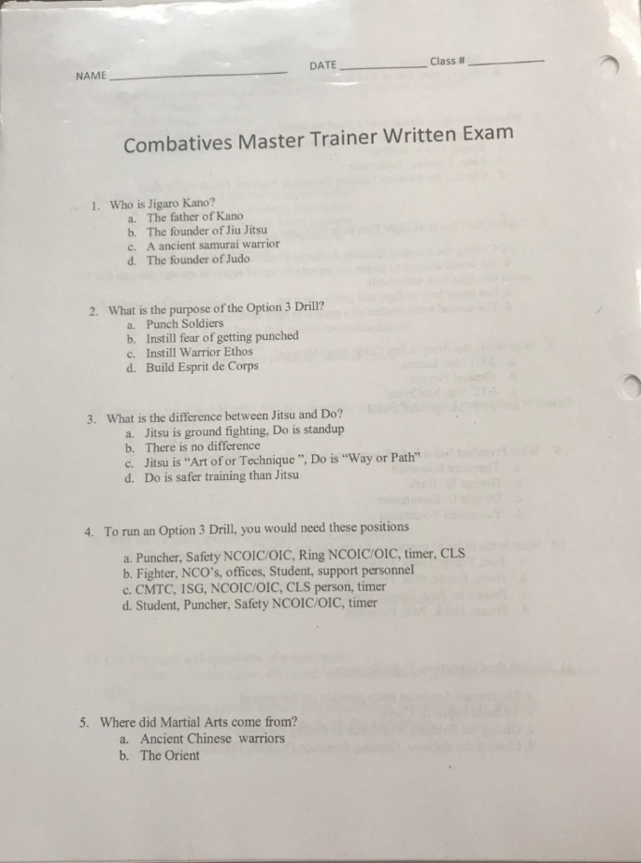
UNITED STATES ARMY COMBATIVES COURSE
1/29 Infantry Regiment, Fort Moore, GA
RPT Handout
History of Combatives
Course Technical Evaluation
Course Written Evaluation
Notes:
RPT Handout: Restorative Physical Training guidelines and exercises. A hard copy should be given to the students for each warm-up. Available on the USACC website.
History of Combatives: Available on the USACC website. Same for each course so instructors only need one copy to distribute despite having several courses.
Course Technical Evaluation: Instructors should have a hard copy of the technical evaluation for each different course they instruct. BCC and TCC Technical Evaluations are both available on the USACC Website.
Course Written Evaluation: Instructors should have a hard copy of the written evaluation and the answer key for each different course they instruct. Both BCC and TCC evaluations are available on the USACC website.

Slide 10
UNITED STATES ARMY COMBATIVES COURSE
1/29 Infantry Regiment, Fort Moore GA
Realistic Training 1
Realistic Training 2
Realistic Training 3
Realistic Training 4
Notes:
Realistic Training 1-6: (Only 1-4 pictured above) Available for download on the USACC Website. Required topics of discussion for the BCC, however there are many relevant concepts and discussions in the TCC as well.

Slide 11
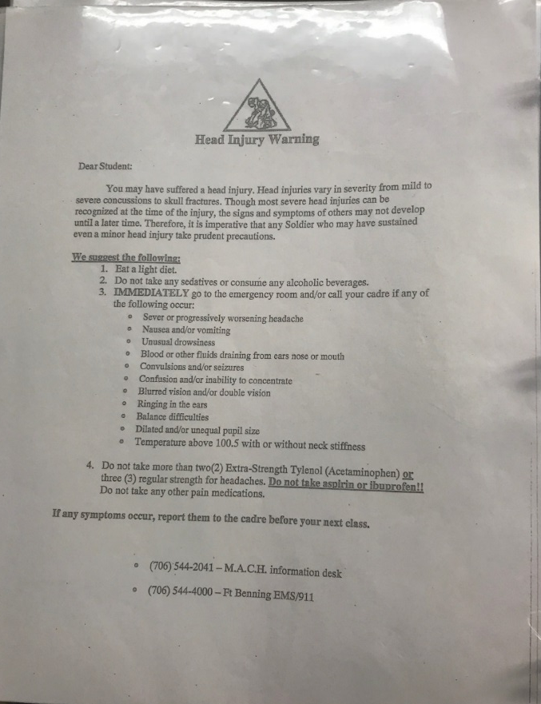
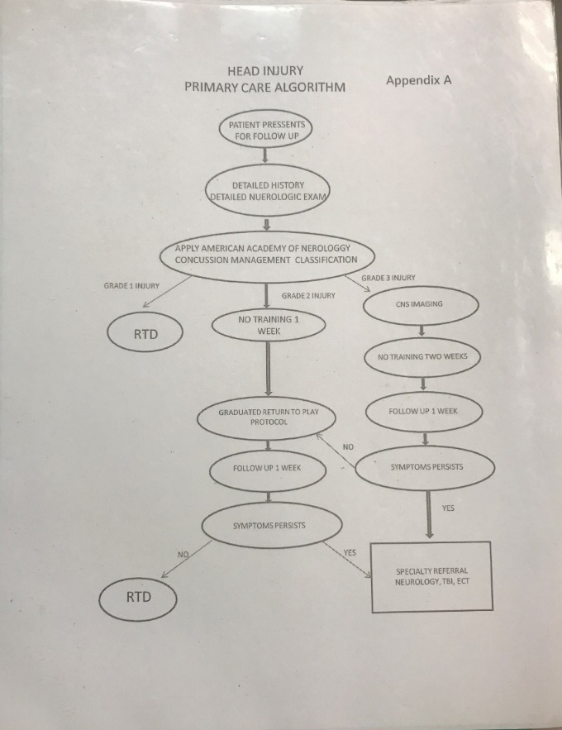
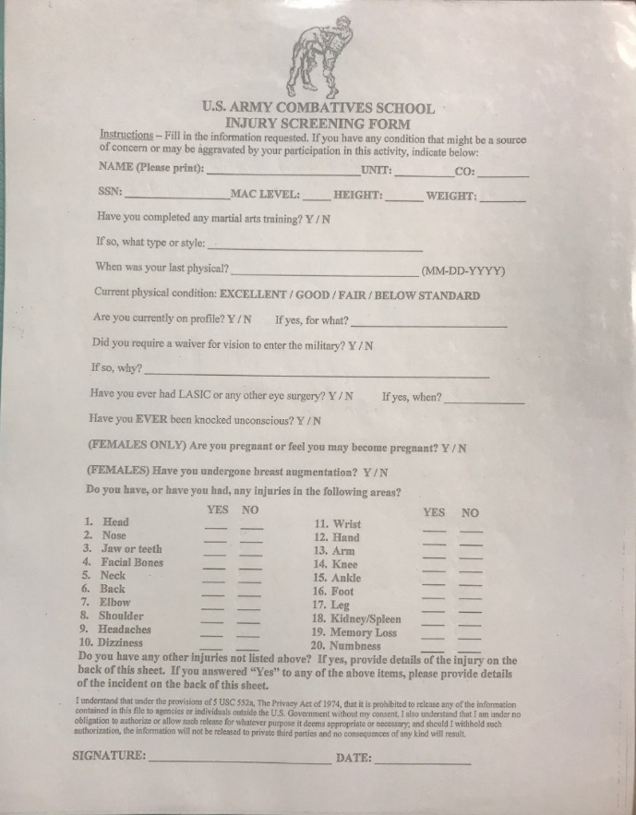
UNITED STATES ARMY COMBATIVES COURSE
1/29 Infantry Regiment, Fort Moore GA
Head Injury Handout
Head Injury Protocol
Injury Screening Form
Notes:
Head Injury Handout: Should have a copy available to hand out to the students before and after high risk training (i.e. Option 3 Drill, Bouts, React to Man-to-Man Contact Drill, etc.).
Head Injury Protocol: Will vary by unit. Get with a medical provider at your post or unit to create a protocol for possible head injuries that occur during the course. One protocol is sufficient for all courses that an instructor teaches.
Injury Screening Form: Can be a standard sick call form. Should have a blank copy available for students who sustain an injury during the course.

Slide 12
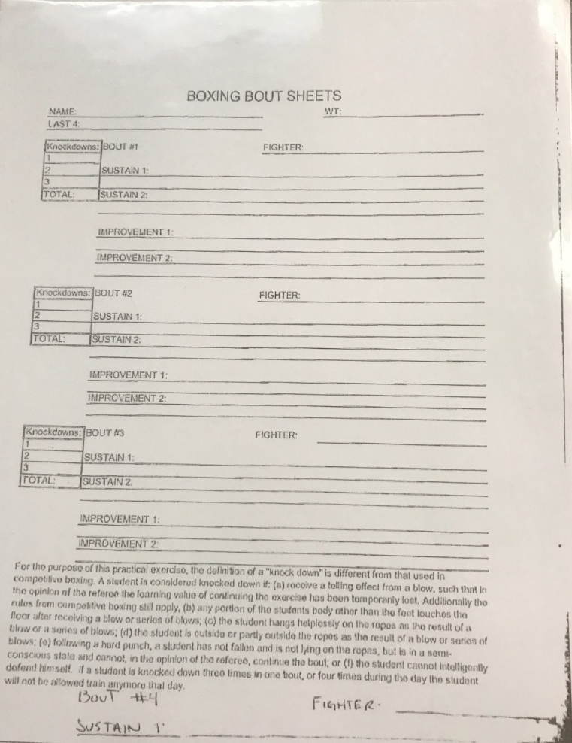
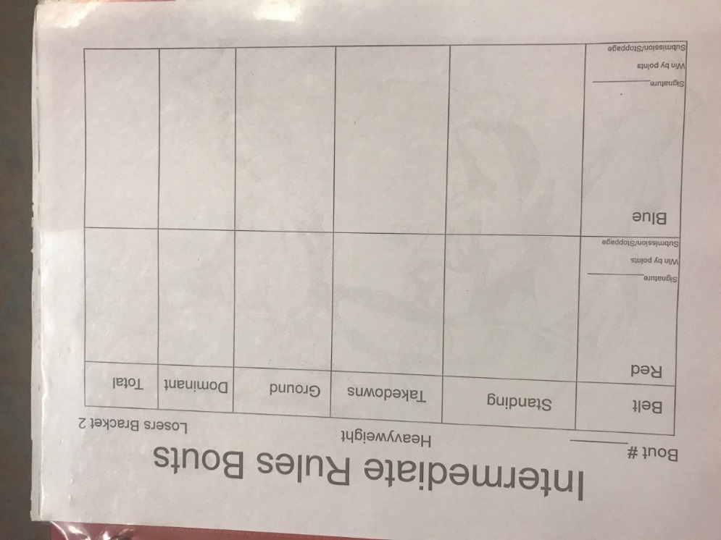
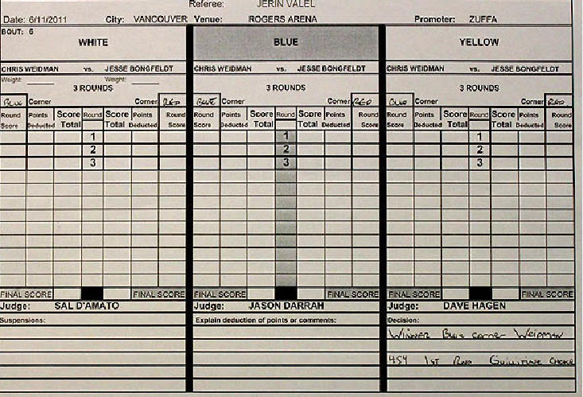
UNITED STATES ARMY COMBATIVES COURSE
1/29 Infantry Regiment, Fort Moore GA
Bout Sheets
Bout Score Sheet (5- Point Must)
Bout Score Sheet (10-Point Must)
Notes:
Bout Sheets: *TCC Specific. Used during bouts for students to practice coaching other students who participate in the bouts and to give feedback.
Bout Score Sheet (5-Point Must): *TCC/Tournament Specific. Scoring system for Intermediate Rules Bouts.
Bout Score Sheet(10-Point Must): *TCC/Tournament Specific. Scoring system for Advanced Rules Bouts.
Tactical Scenario Bout Sheet (Not Pictured): Same as the Intermediate Rules Bout Sheet (5-Point Must), except scoring criteria is different. Refer to TC 3-25.150 for scoring criteria.

Slide 13
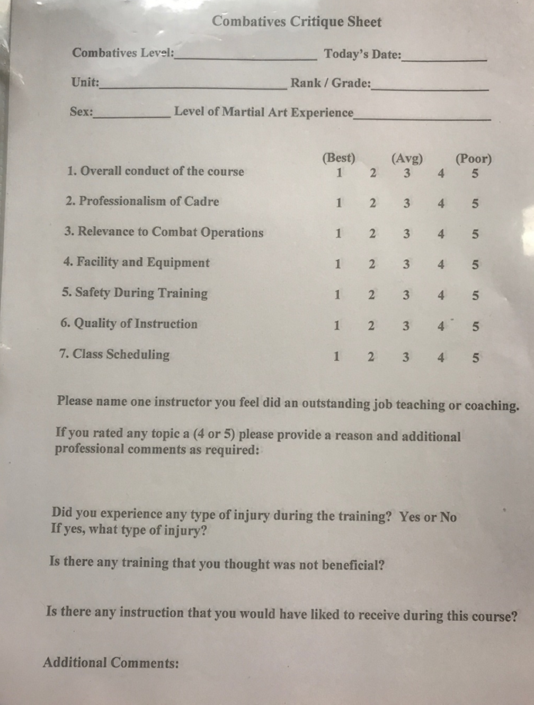
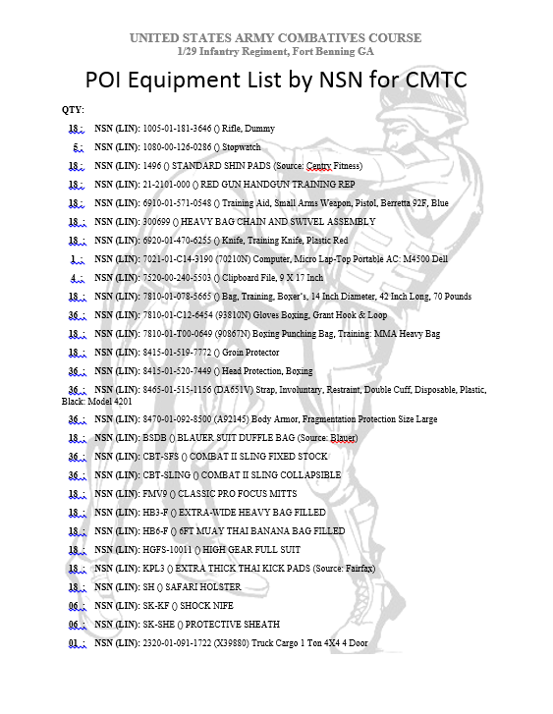
UNITED STATES ARMY COMBATIVES COURSE
1/29 Infantry Regiment, Fort Moore GA
Critique Sheet
Equipment & NSN’s
Notes:
Critique Sheet: All instructors should have a critique sheet, regardless of the Course. One critique sheet can work for several different courses. Available on the USACC website.
Equipment & NSN’s: List of all equipment and all NSN’s required for effective training. Can be combined for several courses or can be course specific based on the training location.

